Slide 1
Dairy Cattle Fertility After 12 Years of Genomic Selection: Lessons Learned, Current Applications, and Future Developments
John B. Cole
Animal Genomics and Improvement Laboratory
USDA, ARS
Beltsville, MD 20705-2350
john.cole@usda.gov
john.cole@urus.org
Peter J. Hansen
Department of Animal Sciences
University of Florida
Gainesville, FL 32611-0920
pjhansen@ufl.edu

Slide 2
Take-home messages
Genomic selection was a critical tool for stopping the decline in Holstein cow fertility, and the fertility of the Holstein cow is now slowly but steadily improving.
You can improve fertility in your herd by using bulls with high genomic breeding values for fertility traits, and you will see those changes in one generation.
Availability of low-cost, high-density genetic marker panels and whole-genome sequence data has allowed us to identify genes associated with large effects on fertility, and to dissect the biology of gametogenesis, fertilization, and development.

Slide 3
Take-home messages (cont’d)
Continued development of reproductive technologies such as sexed semen, oocyte pickup, and embryo transfer has provided dairy farmers with new tools to increase rates of genetic gain.
Other current and anticipated advances in reproductive management, including timed artificial insemination and development of remote sensing technologies, will allow farmers to improve the fertility of their herds and increase their profitability.

Slide 4
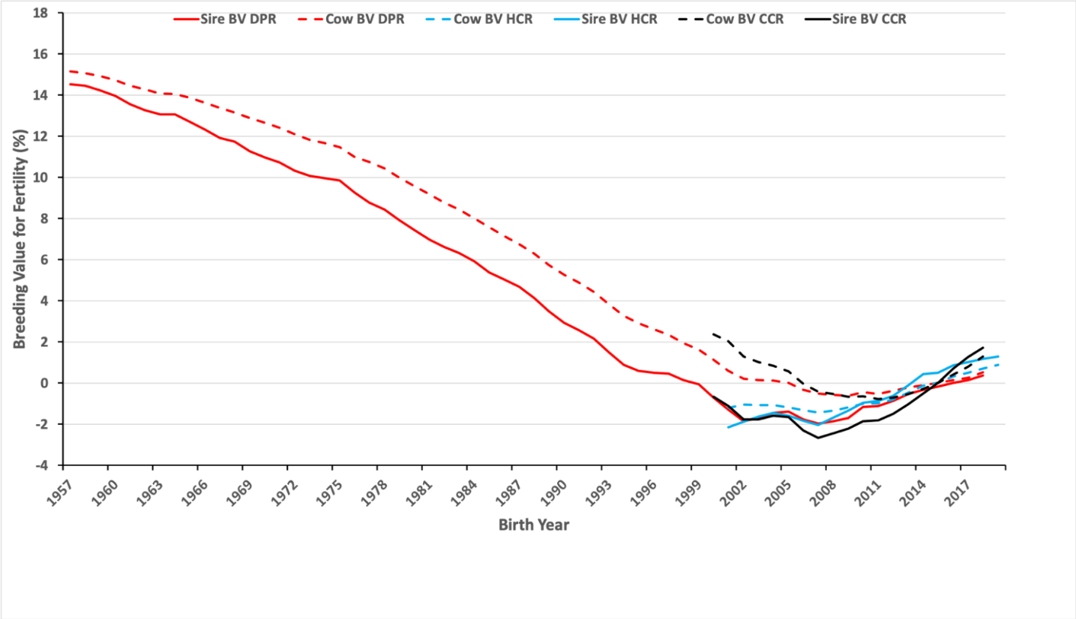
Trends in U.S. Holstein fertility

Slide 5
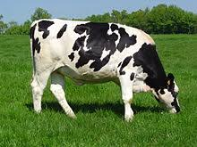
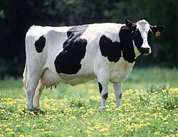
How do we measure fertility?
Daughter Pregnancy Rate: Percentage of nonpregnant cows that become pregnant during each 21-day period.
Early First Calving: Age at first calving with the sign flipped.
Heifer Conception Rate: Heifer’s ability to conceive – the percentage of inseminated heifers that become pregnant at each service.
Cow Conception Rate: Lactating cow’s ability to conceive – the percentage of inseminated cows that become pregnant at each service.

Slide 6
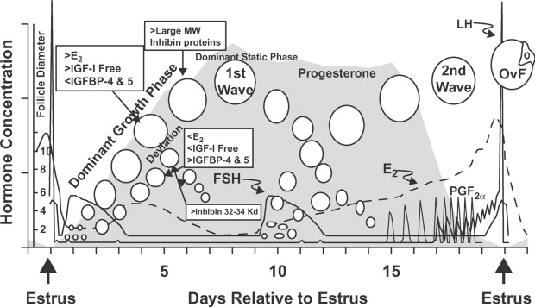
Are these good measures of fertility?
They are things we can easily measure on many cows
Low heritabilities suggest they’re not very good measures of cow biology
What to measure instead?
  Milk progesterone
  Milk PAG
  Anti-Müllerian hormone
Source: Moore and Thatcher (2006; PMID: 16537958)

Slide 7

How does genetic selection work?
ΔG = genetic gain each year
reliability = how certain we are about our estimate of an animal’s genetic merit (genomics ⬆)
selection intensity = how selective we are when making mating decisions (management can ⬆)
genetic variance = variation in the population due to genetics (we can’t really change this)
generation interval = time between generations (genomics ⬇)

Slide 8
Many things affect performance
P = G + E
Genetics
Additive effects
Dominance effects
Epistasis
Environment
Housing
Climate
Unknown
What about G×E?
Effects are generally small in the US (e.g., Wright and VanRaden, 2015), but Tiezzi et al. (2017, PMID: 28109596) suggest they can affect prediction accuracy

Slide 9
Sources of phenotypic variation
Fat yield (h² = 0.20)
Genetics: 20 %
Environment: 80%
Daughter pregnancy rate (h² = 0.04)
Genetics: 4 %
Environment: 96%
Who controls what?
Genetics: Variance is constant
Environment: Farmers can change this

Slide 10
HOW DID GENOMICS CHANGE THINGS?

Slide 11
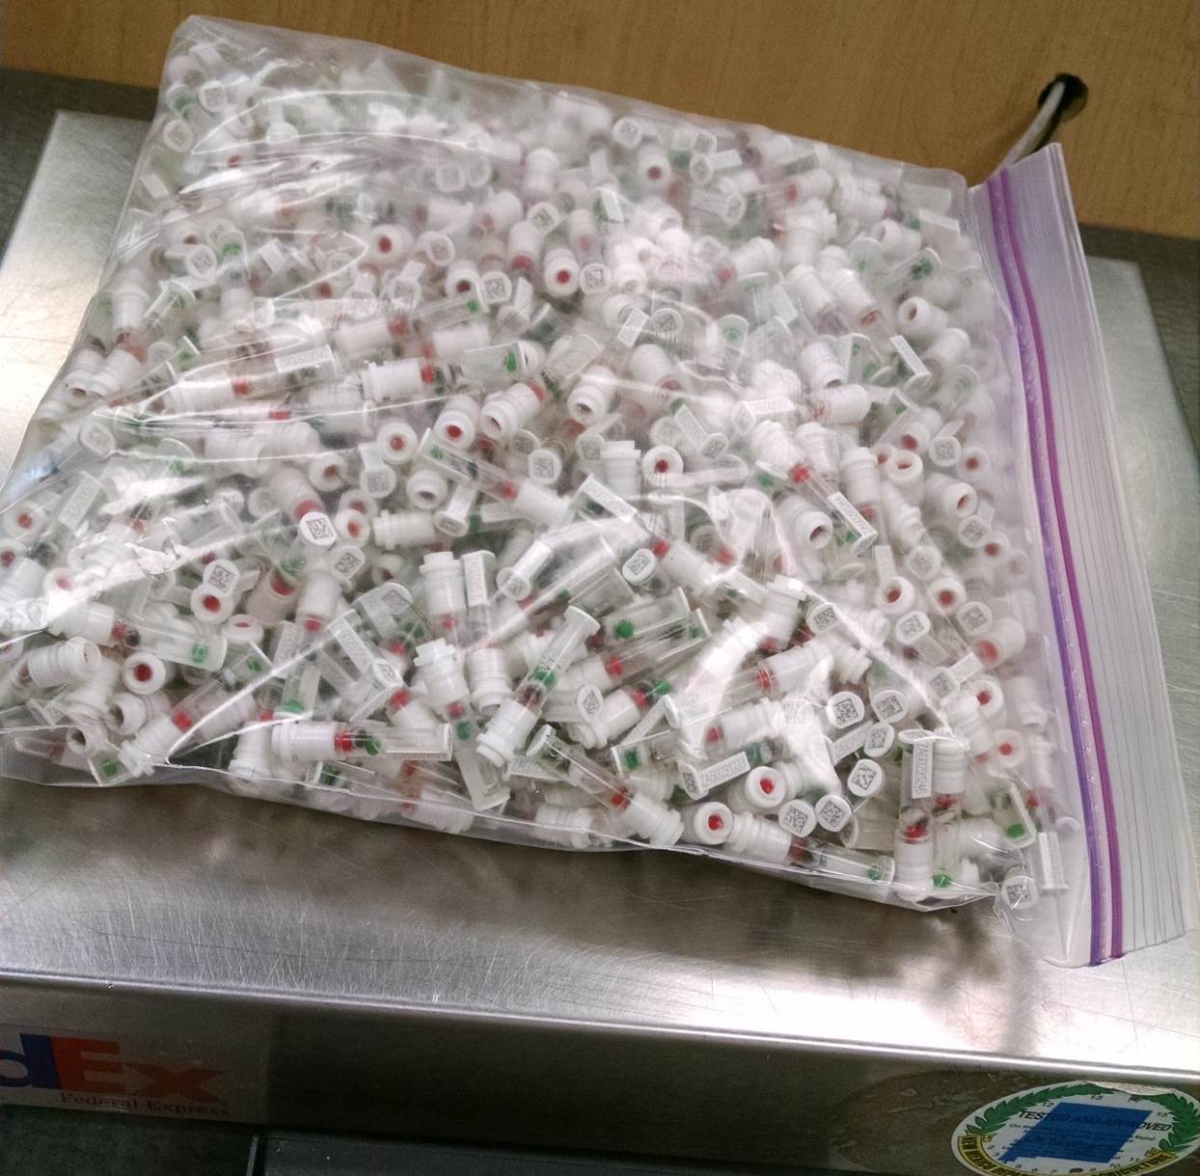
How does genomics work?
I was taught that you select for highly heritable traits and manage lowly heritable traits
Genomic selection makes it
possible to rank bulls for lowly
heritable traits early in their life
  Fertility traits average ~20%
  reliability gain from genomics
There are now ~3.5 million genotyped
cows in the national database!
Source: Zoetis.

Slide 12
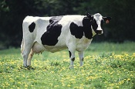
What’s a single SNP genotype worth?
Pedigree is equivalent to information on ~7 daughters
For protein yield (h²=0.30), a SNP genotype provides information equivalent to an additional ~32 daughters
Notes:
12

Slide 13

What’s a single SNP genotype worth?
For daughter pregnancy rate (h²=0.04), a SNP genotype is equivalent to ~181 daughters
Notes:
13

Slide 14
Genomic selection works!
Source: García-Ruiz et al. (2016; PMID: 27354521)

Slide 15
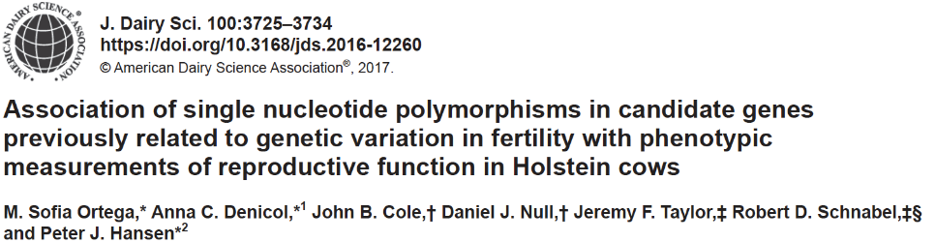
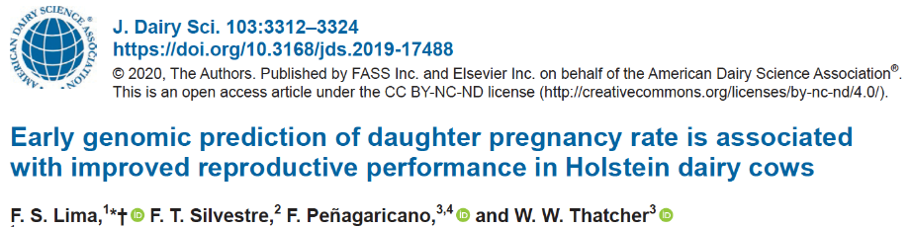
Are we going in the right direction?
Cows with PTA for DPR > 1 (n = 1,285) had higher pregnancy rate at first service, fewer services per conception, and fewer days open that cows with a DPR < -1.
Holstein cows (n = 4,445) with genomic PTA for DPR in the top quartile had greater pregnancy rates, fewer days open, and fewer services to conception than cows with PTA in the bottom quartile.

Slide 16
Inbreeding is increasing faster than in the past
Source: CDCB (2019)

Slide 17
WHERE ARE WE TODAY?

Slide 18
Knowledge of reproductive biology advancing rapidly
Candidate genes have improved accuracy (Ortega et al., 2016, PMID: 26923315)
  39 markers +0.20% versus +0.40% from 727,000 SNP
A single change in COQ9 had favorable effects on cellular oxygen metabolism, body weight changes, and ovarian function (Ortega et al., 2017, PMID: 28339599)
Source: Ortega et al. (2017, PMID: 28339599)

Slide 19
Knowledge of reproductive biology advancing rapidly
Different training sets result in different QTL (Parker Gaddis et al., 2016, PMID: 27209127)
  Which signals are “real”?
Success of embryo transfer is under some degree of genetic control (Jaton et al., 2016, PMID: 27522410; Parker Gaddis et al., 2017, PMID: 28131573)
  This means we can select for better outcomes
Source: Parker Gaddis et al. (2016, PMID: 27209127).

Slide 20
Renewed appreciation of andrology
Use of sexed semen is commonplace (e.g., Burnell, 2019).
  Numbers difficult to find
Sex-sorted semen have different motility and reduced rates of embryonic development (Steele et al., 2020).
Consistent with Ortega et al. (2018) who found bulls with high SCR produce more fertilized oocytes and fewer degenerate embryos than low-sire SCR bulls.
Interactions of sperm and the female reproductive tract are crucial for sperm survival (Pollard et al., 1991; Kumaresan et al., 2019).

Slide 21
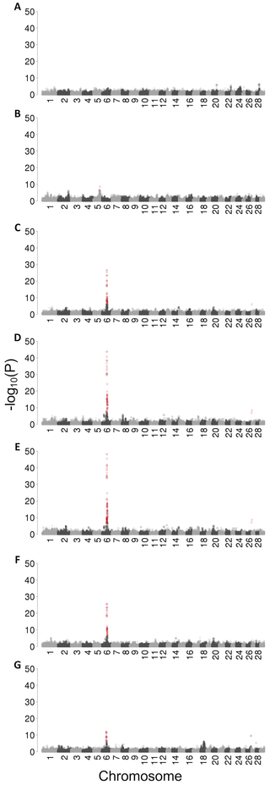
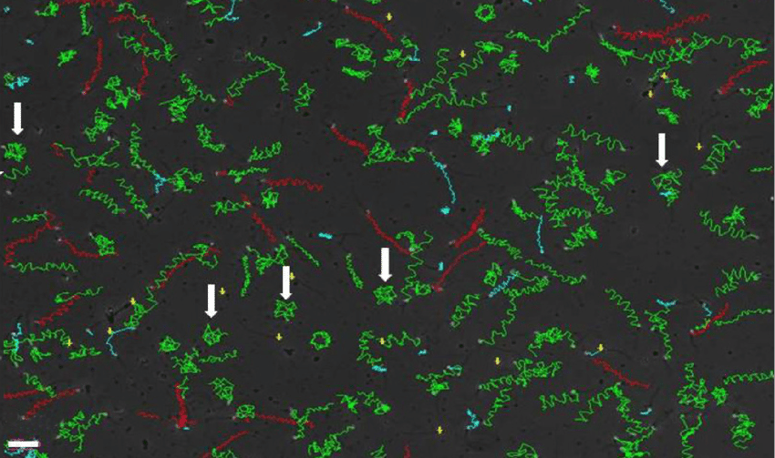
Renewed appreciation of andrology (cont’d)
Genotypes for bulls entering AI are being used to identify causal variants for genetic differences in fertility among bulls (Hiltpold et al., 2020).
Advances in flow cytometry and machine learning may increase the accuracy of bull fertility evaluations (Bucher et al., 2019).
Source: van der Horst and du Plessis (2017)
Source: Hiltpold et al. (2020)

Slide 22

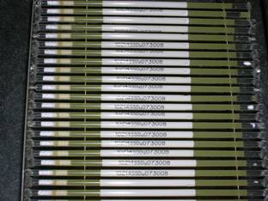
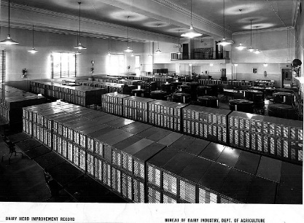
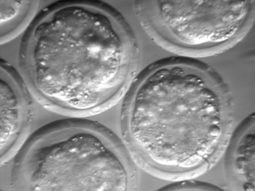
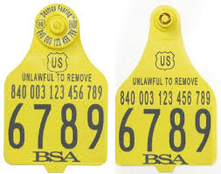
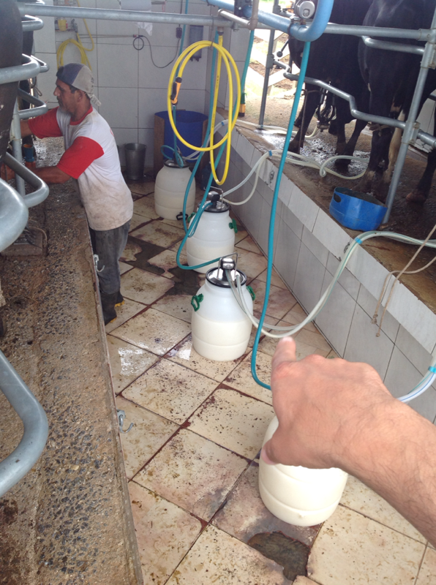
Dairy farmers have embraced new tools
Sexed semen now commonly used in heifers and cows
  Little difference in fertility
Beef-on-dairy
  Enabled by use of sexed semen to generate replacements
Are benefits shared by all?
  Labor needs driven by farm size
Source: http://vet.tufts.edu/tas/images/002.png.
Source: http//www.shopbrownswiss.com/.

Slide 23
WHERE ARE WE GOING?

Slide 24
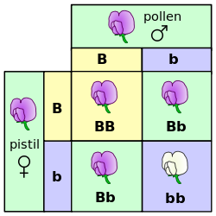
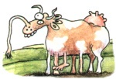
What Should We Do About Genetic Diseases?
Genetic diseases are inevitable in finite populations
Inbreeding can increase the rate at which defects spread
Breeders often disincentive to share information
Source: https://commons.wikimedia.org/wiki/File:Punnett_square_mendel_flowers.svg.

Slide 25
Known recessives in U.S. Holsteins (February 2020)
Haplo- type | Functional/Gene name | BTA chromosome | Location (Mbp) | Haplotype frequency (%) | Timing¹
HBR | Black/red coat color/MC1R(MSHR) | 18 | 14.8 | 0.75 | —
HCD | Cholesterol deficiency/APOB | 11 | 78.0 | 2.28 | W
HDR | Dominant red color/MC1R(MSHR) | 3 | 9.5 | 0.03 | —
HH0 | Brachyspina/FANCI | 21 | 21.2 | 1.65 | E,B
HH1 | APAF1 | 5 | 63.2 | 1.28 | E
HH2 | — | 1 | 94.9 – 96.6 | 1.21 | E
HH3 | SMC2 | 8 | 95.4 | 2.64 | E
HH4 | GART | 1 | 1.3 | 0.23 | E
HH5 | TFB1M | 9 | 93.2 – 93.4 | 2.39 | E
HH6 | SDE2 | 16 | 29.0–29.1 | 0.44 | W
HHB | BLAD/ITGB2 | 1 | 145.1 | 0.21 | W
HHC | CVM/SLC35A3 | 3 | 43.4 | 1.10 | E,B
HHD | DUMPS/UMPS | 1 | 69.8 | 0.01 | E
HHM | Mule foot/LRP4 | 15 | 77.7 | 0.05 | B
HHP | Polledness (dominant)/POLLED | 1 | 1.7 – 2.0 | 0.88 | —
HHR | Red coat color/MC1R(MSHR) | 18 | 14.8 | 3.29 | —
¹Timing of embryonic loss/calf death for homozygous animals: B = calf death at/shortly after birth,
E = embryonic loss/abortion, W = calf death weeks/months after birth (Cole et al., 2018; https://bit.ly/2utjPbT).

Slide 26
Timing of recessive effects
Late losses cost more than early losses (Cole et al., 2016; PMID: 27394947)
  Jenko et al. (2019; PMID: 30836944) found similar results
A defect can cause deaths in more than one time period
Embryonic loss or abortion | Death at or near birth | Weeks or months following birth
BH1, HH0, HH1, HH2, HH3, HH4, HH5, CVM, JH1, JH2 | BH2, HH0, CVM, syndactyly (mulefoot) | AH1, BH2, HH6, BLAD, cholesterol deficiency, spinal dysmyelination, spinal muscular atrophy, weaver syndrome

Slide 27
Estimated cost of genetic load
Cole et al. (2016; PMID: 27394947) estimated annual losses of at least $10.7 million due to known recessives.
Average losses were $5.77, $3.65, $0.94, and $2.96 in Ayrshire, Brown Swiss, Holstein, and Jersey, respectively.
This is the economic impact of genetic load as it affects fertility and perinatal mortality.
Actual losses are likely to be higher.

Slide 28
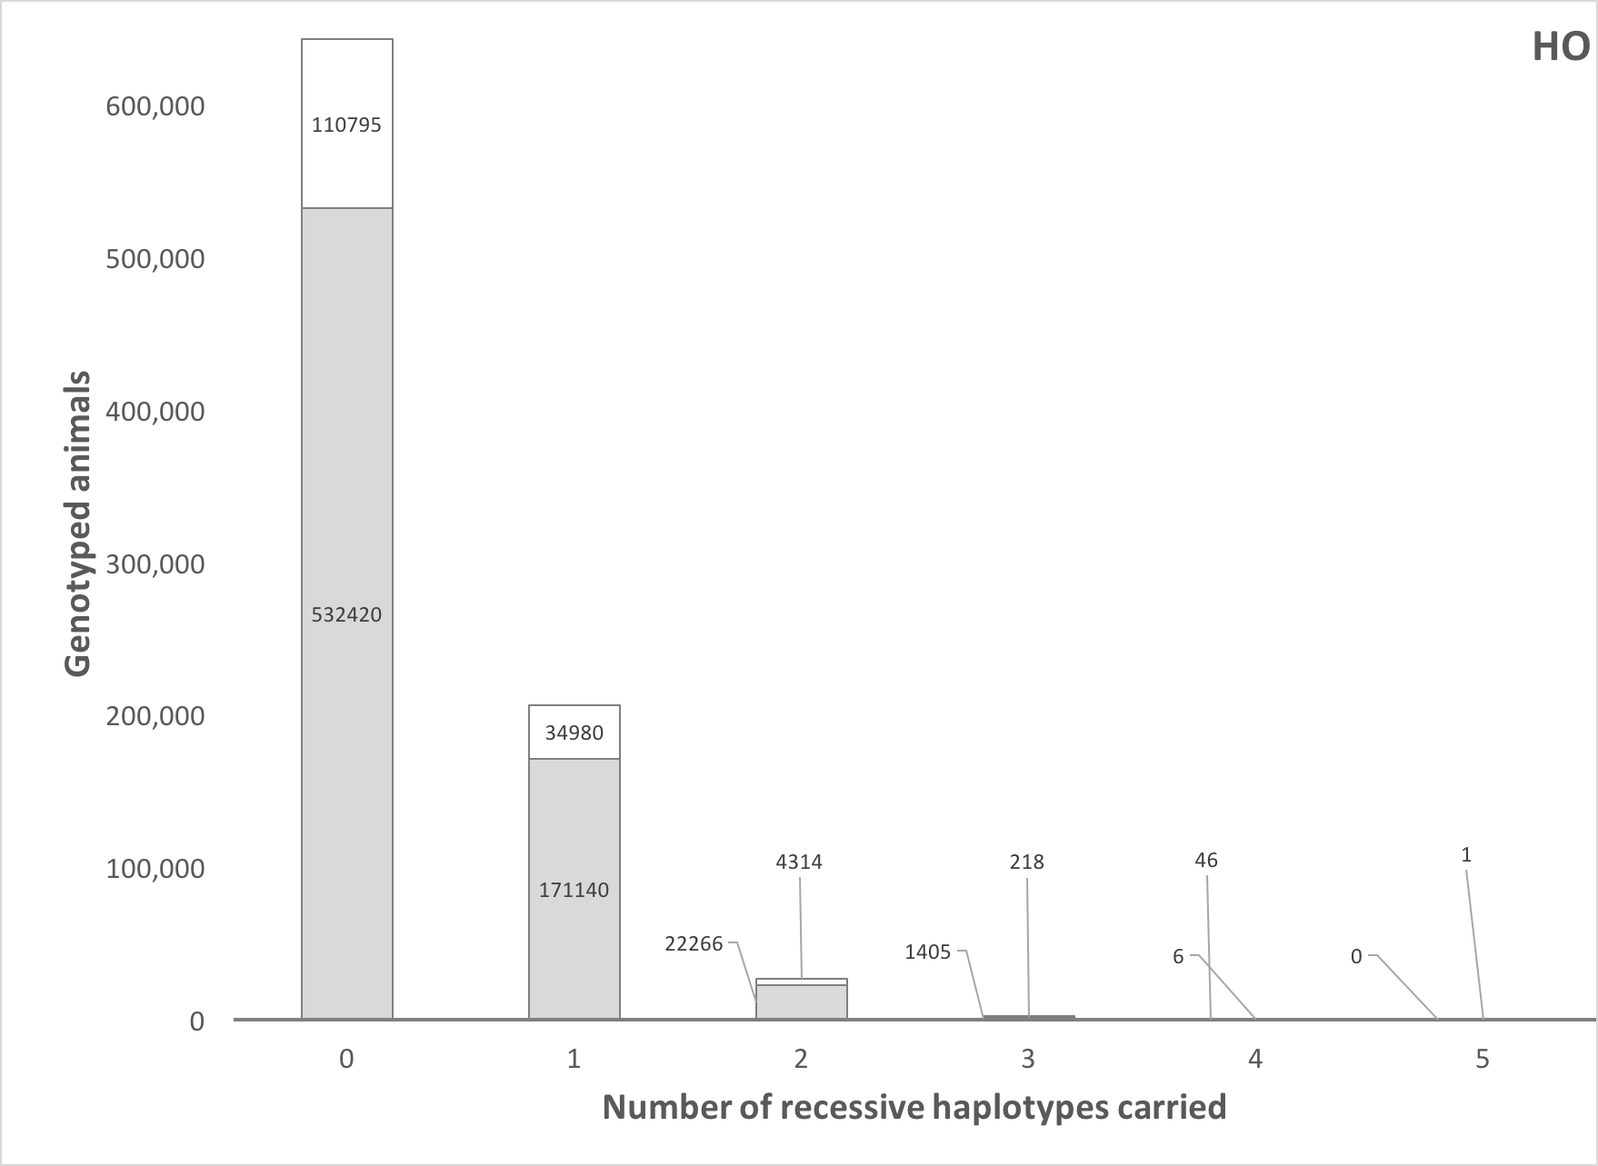
How many defects do animals carry?
Source: Cole et al. (2016; PMID: 27394947).

Slide 29
Is the number of genetic defects increasing?
MacArthur et al. (2012; PMID: 22344438) estimated that human genomes contain ~100 loss-of-function mutations, and ~20 completely inactivated genes
The mutations are there even if we have not identified them yet
  Example: HH6, mutation in SDE2 (Fritz et al., 2018; PMID: 29680649)
Our detection methods are improving as our technology improves
We continue to make many copies of haplotypes from a small number of bulls, uncovering existing genetic load

Slide 30
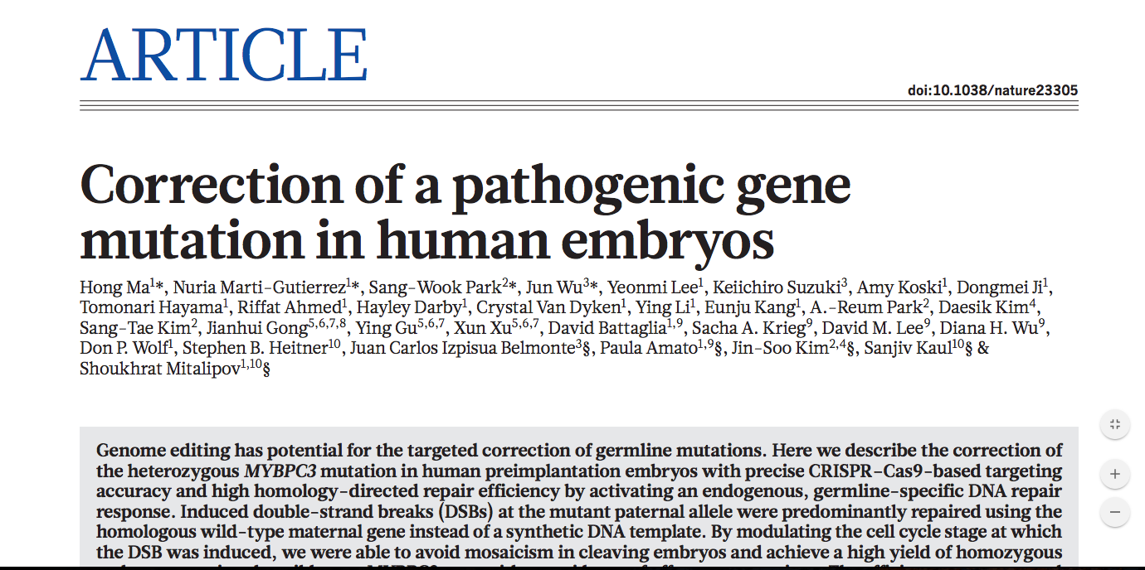
Is gene editing the solution?
Source: Ma et al. (2017; PMID: 28783728).

Slide 31
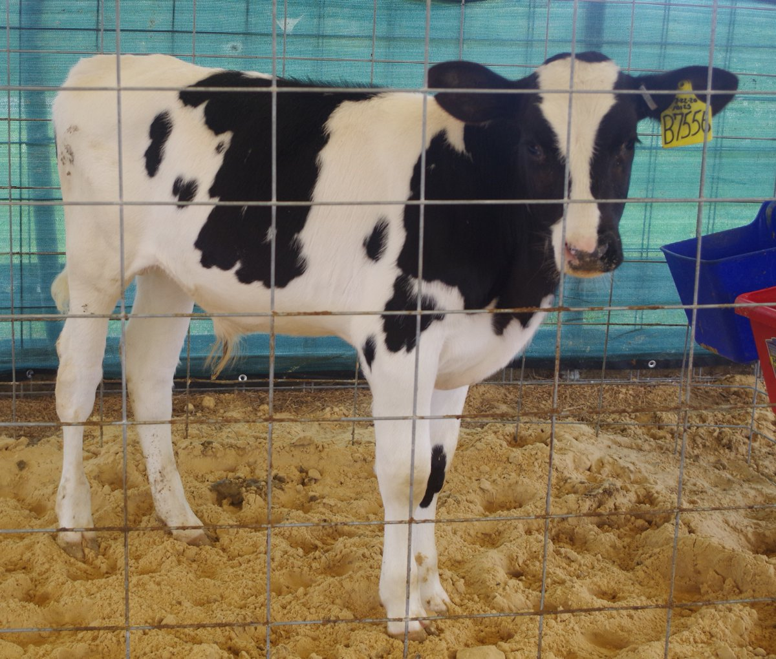
How can we introduce or multiply desirable genes?
Traditional breeding works, but its speed depends on population allele frequencies
If the frequency is very low, it’s almost impossible to make perceptible progress
  e.g., POLLED in Holsteins
It’s can be difficult to identify homozygous bulls with high genetic merit
Slick-Gator Eliab-ET (Source: @ufpjhansen)

Slide 32
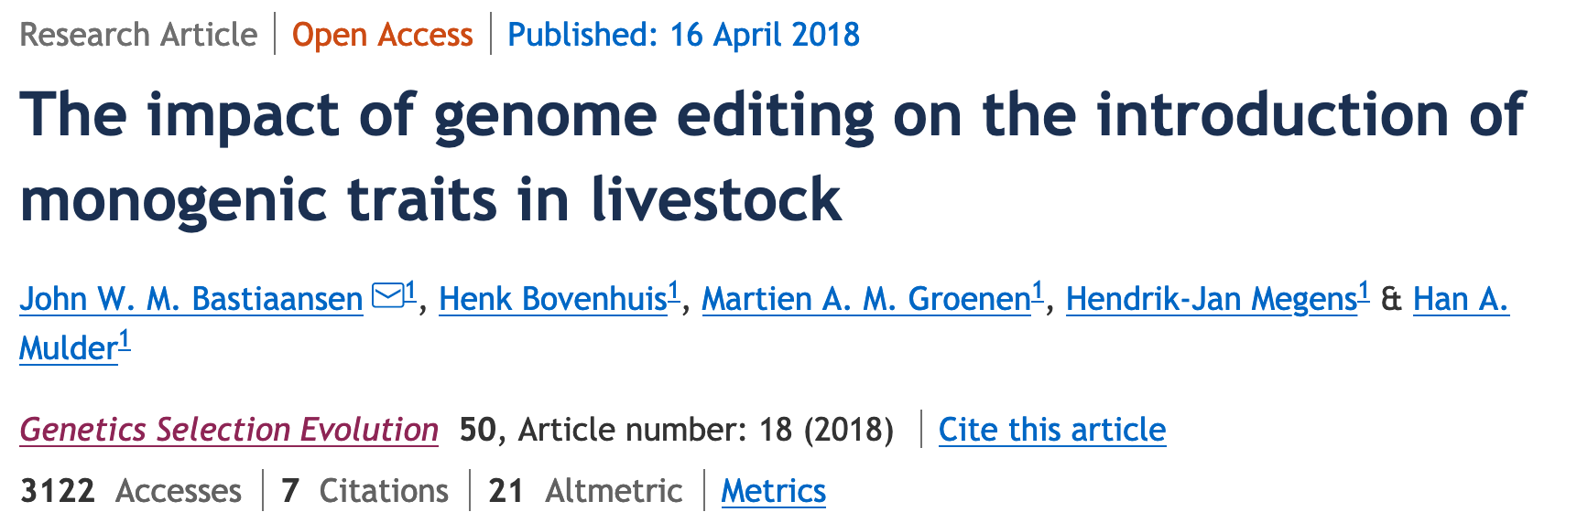
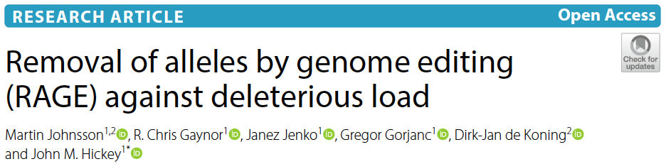
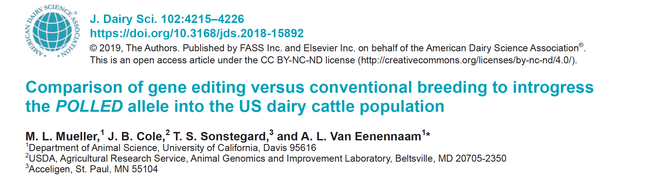
Gene editing may help speed-up the process
Bastiaansen et al. (2019; PMID: 29661133)
Johnsson et al. (2019; PMID: 30995904)
Mueller et al. (2019; PMID: 30852022)

Slide 33
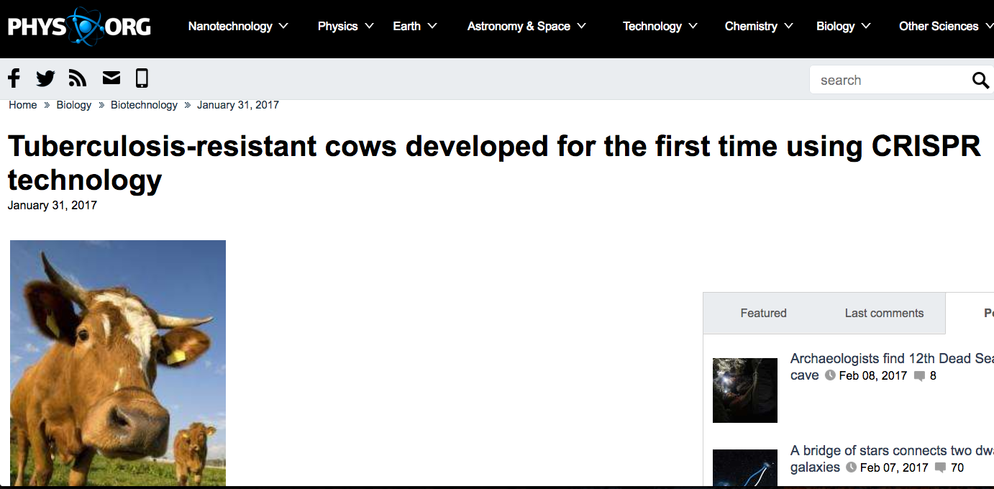
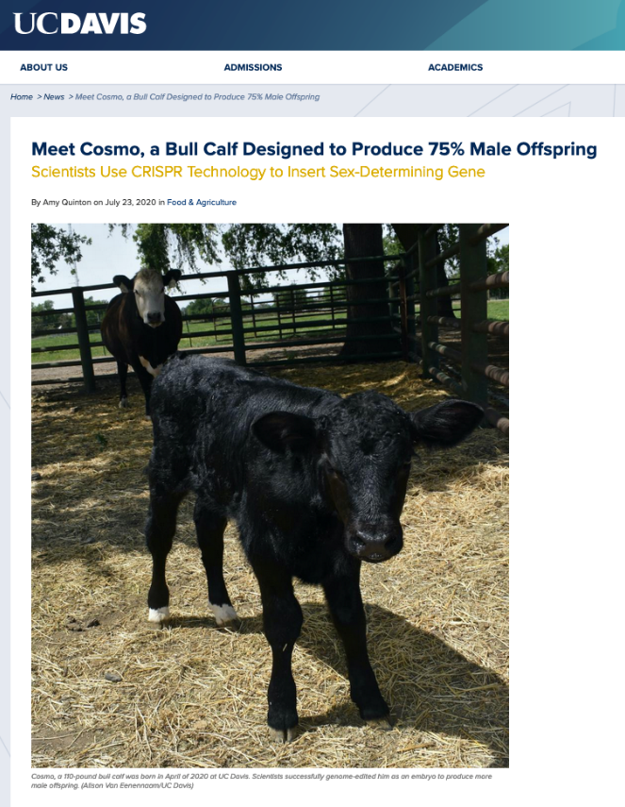
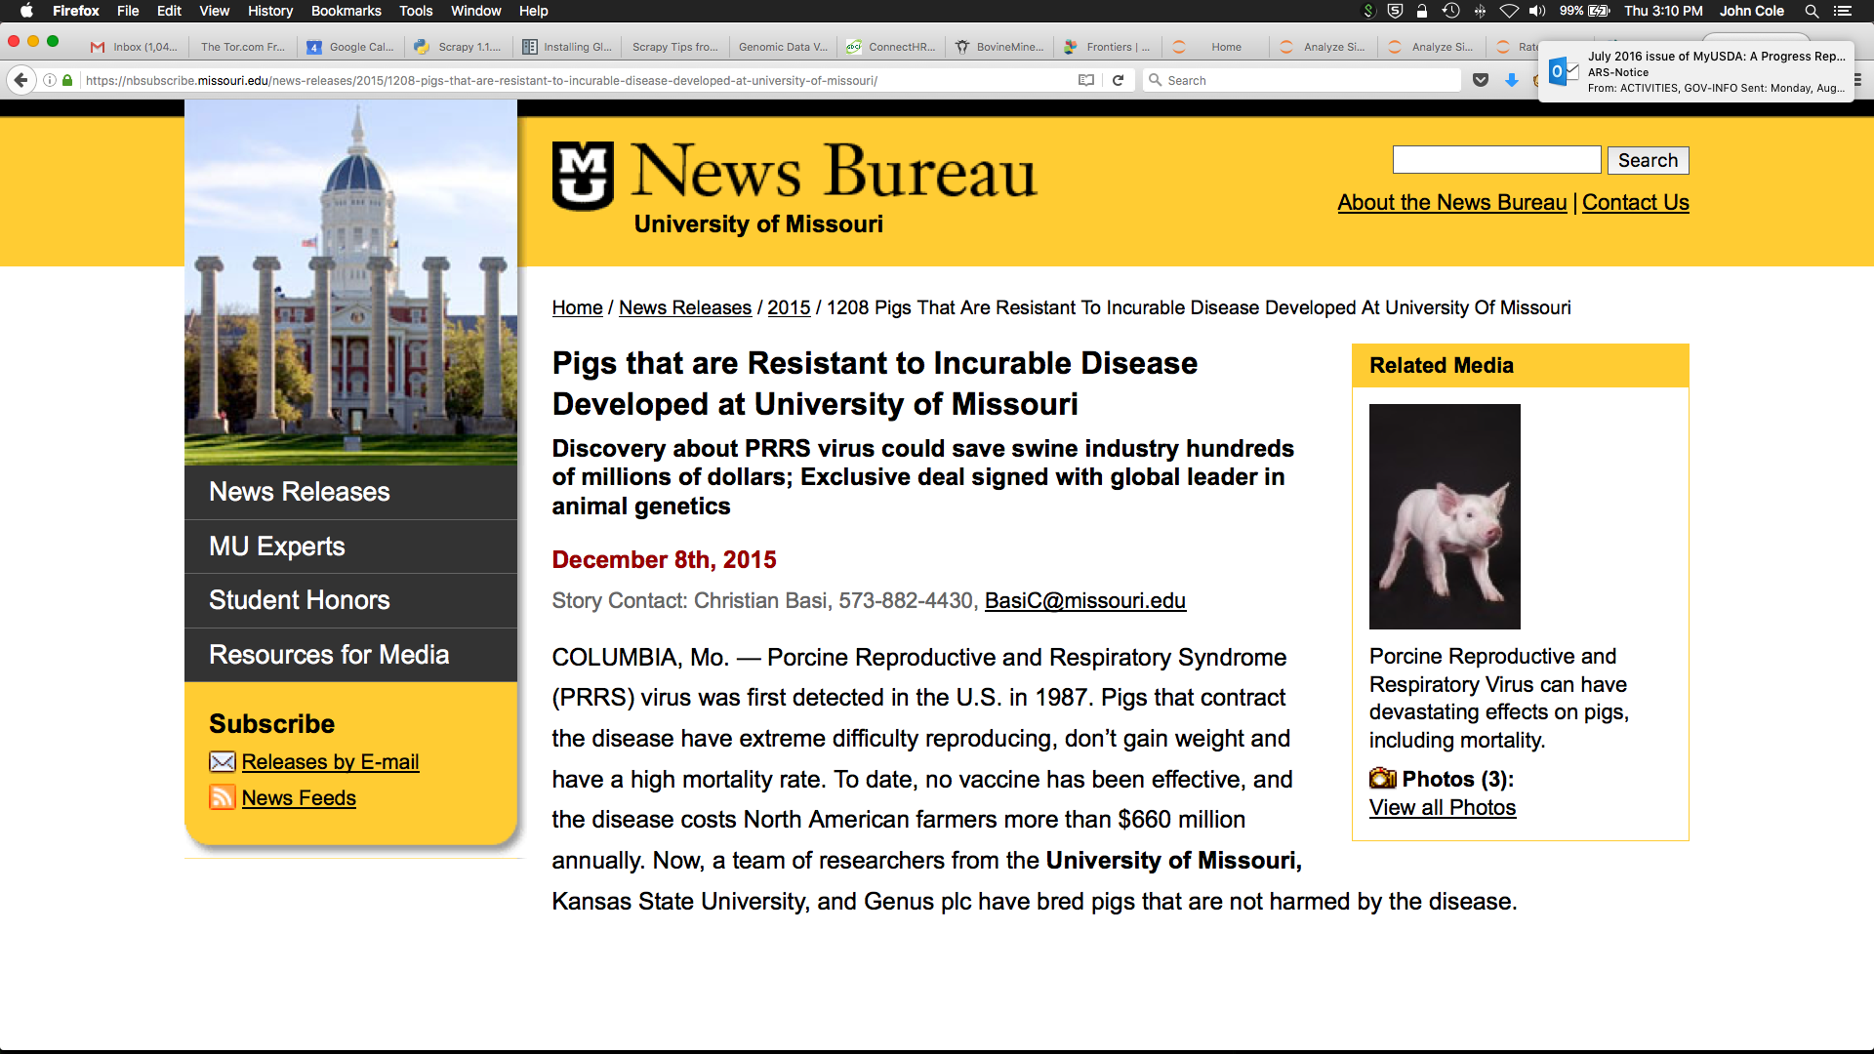
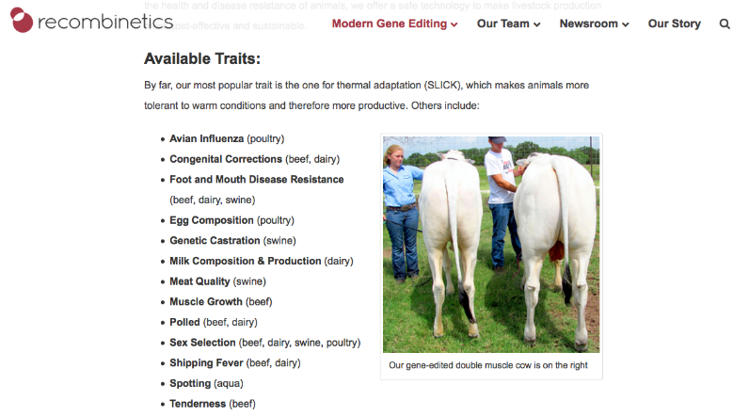
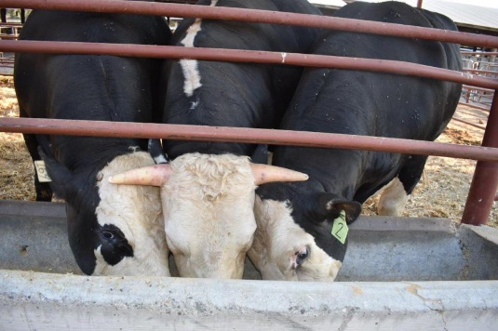
Examples of gene editing in livestock

Slide 34
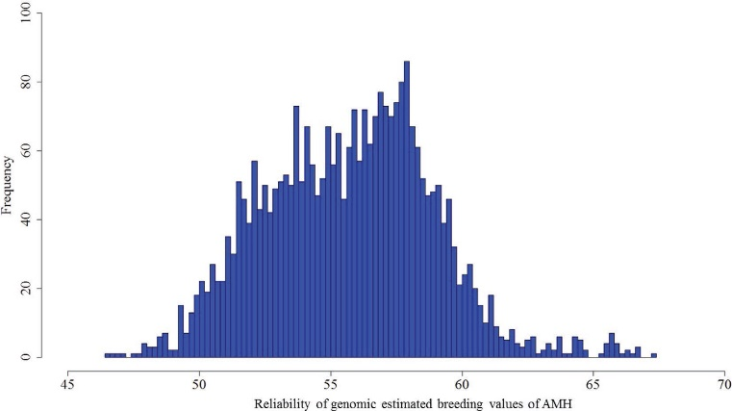
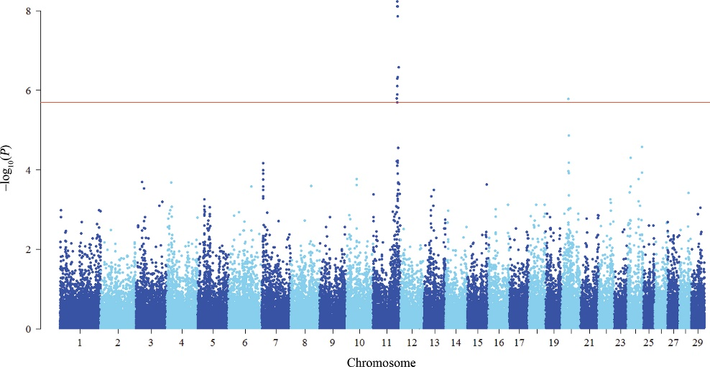
New reproductive traits
Precision technologies may lead to new traits (Boichard and Brochard, 2012)
Concentrations of anti-Müllerian hormone are heritable (Nawaz et al., 2018)
Intervals from calving to estrus and calving to first elevated progesterone concentrations are moderately heritable (Ismael et al., 2015; Tarekegn et al., 2019)
h² ≈ 0.40
Source: Nawaz et al. (2018).

Slide 35
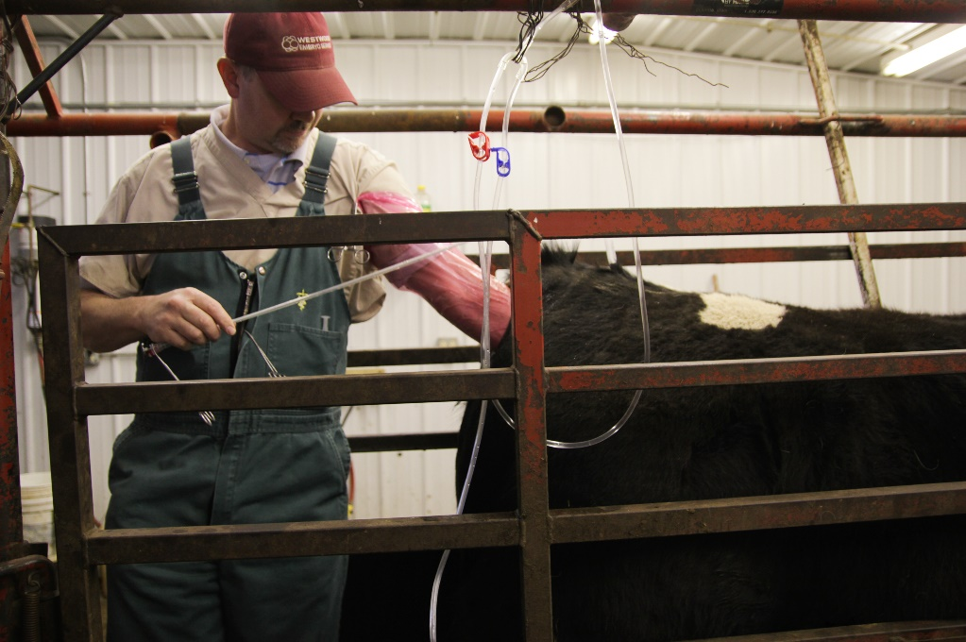
More embryo transfer?
ET is growing in importance on U.S. dairies
The potential to increase the number of offspring from genetically elite females is of growing importance (e.g., Fleming et al., 2018)
Costs of embryo production must decrease and pregnancy rates increase to drive adoption (Hansen, 2020)
Source: Abby Wendle/Harvest Public Media.

Slide 36
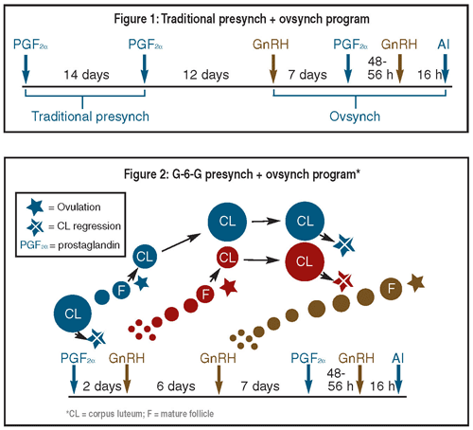
What about reproductive hormones in the long run?
Timed AI depends on the use of exogeneous reproductive hormones
Effectiveness may depend on interactions with specific gene mutations (Zolini et al., 2019)
Changes in consumer sentiment can rapidly change the regulatory landscape (Ufer et al., 2019)
Source: Hoard’s Dairyman (2012).

Slide 37
Conclusions
Dairy cow fertility has been steadily improving since the introduction of genomic selection in 2008.
Genomics have led to a deeper understanding of gamete and cow physiology, as well as enabling more sophisticated strategies for herd management.
We will continue to benefit from discoveries enabled by genomic selection for a very long time.

Slide 38
Disclaimer
Cole was supported by USDA-ARS project 8042-31000-002-00-D, “Improving Dairy Animals by Increasing Accuracy of Genomic Prediction, Evaluating New Traits, and Redefining Selection Goals”.
Hansen has been supported by the L. E. “Red” Larson Endowment and funding from USDA- NIFA (2013-68004-20365 and others), NIH (R01 HD088352), Holstein Association USA, and Foundation for Food and Agriculture Research.

Slide 39
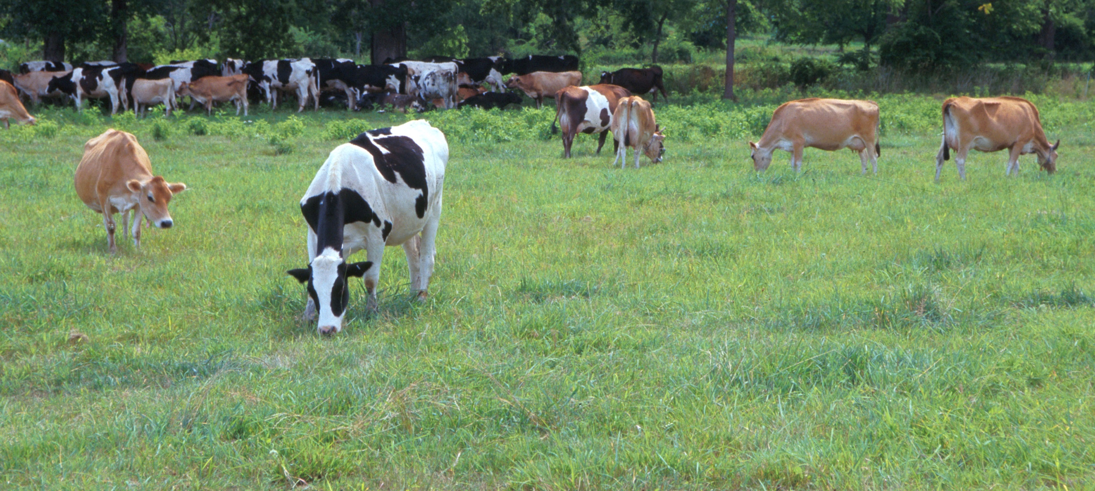
Questions?
AIP web site:
http://aipl.arsusda.gov/
Holstein and Jersey crossbreds graze on American Farm Land Trust’s
Cove Mountain Farm in south-central Pennsylvania
Source: ARS Image Gallery, image #K8587-14; photo by Bob Nichols

